Slide 1
AI Project (Continue)
Classify human electrocardiogram (ECG) signals using the continuous wavelet transform (CWT) and a deep convolutional neural network (CNN).

Slide 2
Training CNN
Training deep CNNs from scratch is resource-intensive and data-demanding.
Transfer learning offers a solution by using pretrained neural networks for similar tasks.
In this case, we apply transfer learning to adapt GoogLeNet.

Slide 3
Dataset
162 ECG recordings from three PhysioNet databases:
MIT-BIH Arrhythmia Database
MIT-BIH Normal Sinus Rhythm Database
BIDMC Congestive Heart Failure Database Recordings

Slide 4
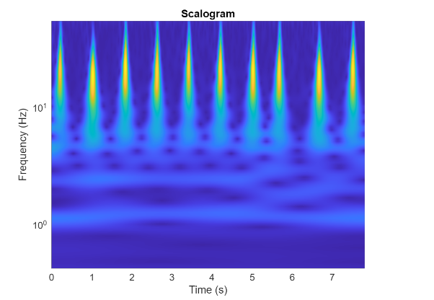
MATLAB: Task 2
Plot a Scalogram with 1000 ECG samples

Slide 5
Divide into Training and Validation Data
Efficient Image Loading with imageDatastore: Automatically labels images based on folder names.
Stores images as an ImageDatastore object, optimized for large datasets.
Handles data that doesn’t fit in memory.
Reads images in batches, ideal for CNN training.
allImages = imageDatastore(fullfile(parentDir,dataDir), ...
"IncludeSubfolders",true, ...
"LabelSource","foldernames");

Slide 6
Divide into Training and Validation Data
Randomly divide the images into two groups, one for training and the other for validation.
Use 80% of the images for training, and the remainder for validation.
[imgsTrain,imgsValidation] = splitEachLabel(allImages,0.8,"randomized");
disp("Number of training images: "+num2str(numel(imgsTrain.Files)))
disp("Number of validation images: "+num2str(numel(imgsValidation.Files)))

Slide 7
GoogLeNet
Load the pretrained GoogLeNet neural network.
Deep Learning Toolbox Model for GoogLeNet Network

Slide 8
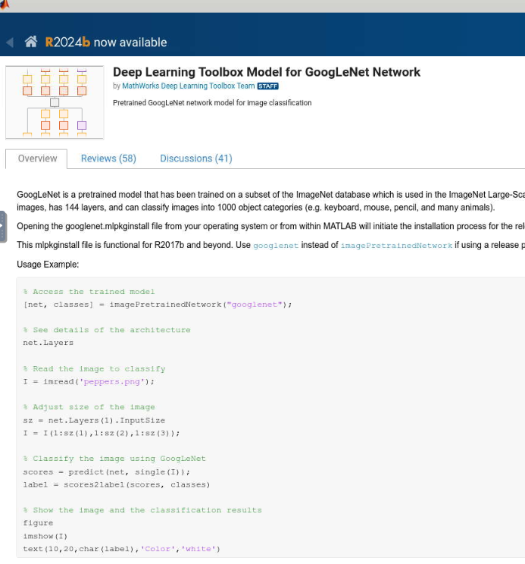

Slide 9
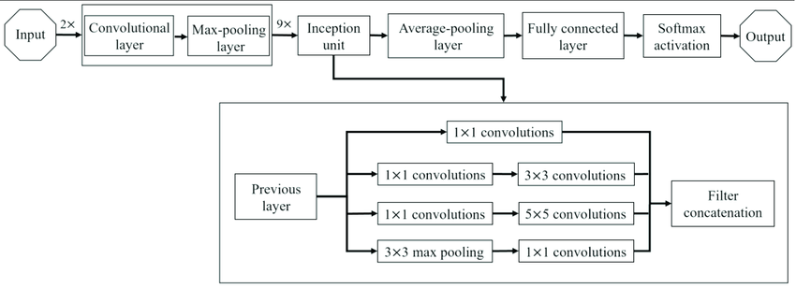
GoogLeNet Architecture
A simplified block diagram of the GoogLeNet Architecture.
https://viso.ai/deep-learning/googlenet-explained-the-inception-model-that-won-imagenet/
https://www.researchgate.net/figure/Simplified-illustration-of-the-GoogLeNet-architecture_fig5_364461190

Slide 10
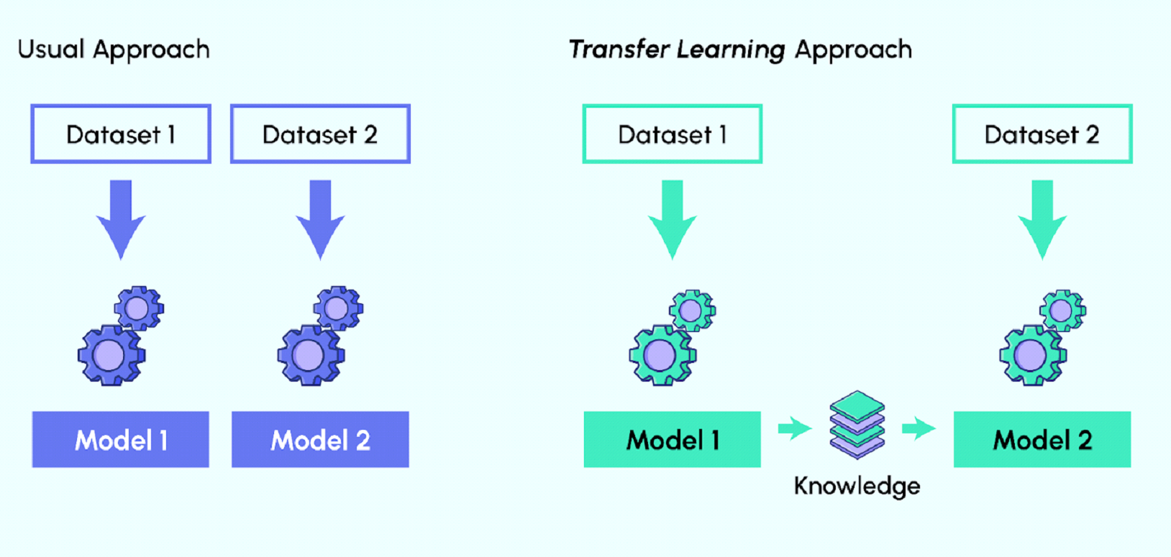
Pretrained model
https://data-science-blog.com/blog/2022/04/11/how-to-choose-the-best-pre-trained-model-for-your-convolutional-neural-network/

Slide 11
Continue MATLAB: Load Pre trained GoogLeNet Neural Network
Step 2.1
net = imagePretrainedNetwork("googlenet");

Slide 12
Observed the Model Network
Step 2.2
numberOfLayers = numel(net.Layers);
figure("Units","normalized","Position",[0.1 0.1 0.8 0.8])
plot(net)
title("GoogLeNet Layer Graph: "+num2str(numberOfLayers)+" Layers")

Slide 13
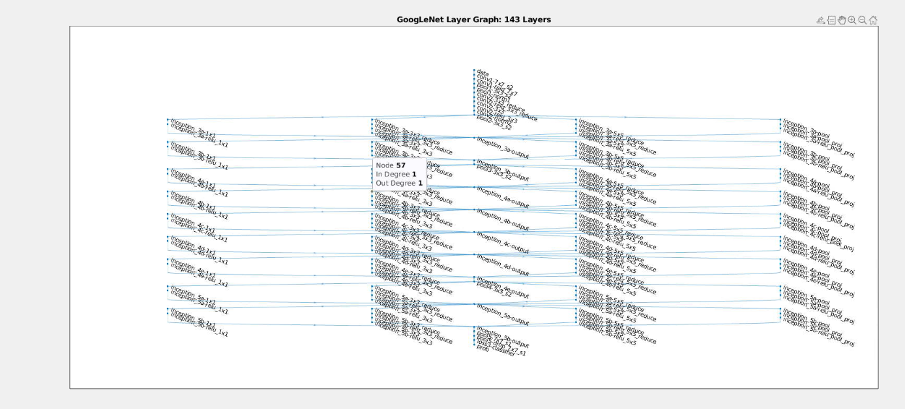
Figure

Slide 14
Task 3: Inspection 1
Step 2.3
net.Layers(1)
Inspect the first element of the network Layers property. Confirm that GoogLeNet requires RGB images of size 224-by-224-by-3.

Slide 15
Task 3: Inspection 2
Q. Observe the second element of the network Layers property and answer the following:
Is it a convolution layer or a max pooling layer?
Number of Channels = ?
Number of Filters = ?
Filter Size = ?
Include answers in your report.

Slide 16
Modify GoogLeNet Network Parameters
Step 2.4
net.Layers(end-3:end)
newDropoutLayer = dropoutLayer(0.6,"Name","new_Dropout");
net = replaceLayer(net,"pool5-drop_7x7_s1",newDropoutLayer);
numClasses = numel(categories(imgsTrain.Labels));
newConnectedLayer = fullyConnectedLayer(numClasses,"Name","new_fc", ...
"WeightLearnRateFactor",5,"BiasLearnRateFactor",5);
net = replaceLayer(net,"loss3-classifier",newConnectedLayer);
net.Layers(end-3:end)

Slide 17
Set Training Options and Train GoogLeNet
sgdm": Specifies the training algorithm (Stochastic Gradient Descent with Momentum).
MiniBatchSize: Number of samples processed before updating the model weights (set to 15).
MaxEpochs: Maximum number of complete passes through the training dataset (set to 20).
InitialLearnRate: Starting learning rate, controlling the step size in weight updates (set to 0.0001)

Slide 18
Set Training Options and Train GoogLeNet
ValidationData: Dataset used to evaluate model performance during training (imgsValidation).
ValidationFrequency: Interval (in iterations) at which validation is performed (set to every 10 iterations).
Metrics: Metric used to evaluate performance (set to "accuracy").

Slide 19
Set Training Options and Train GoogLeNet
Step 2.5
options = trainingOptions("sgdm", ...
MiniBatchSize=15, ...
MaxEpochs=20, ...
InitialLearnRate=1e-4, ...
ValidationData=imgsValidation, ...
ValidationFrequency=10, ...
Verbose=true, ... Plots="training-progress", ...
Metrics="accuracy");
trainedGN = trainnet(imgsTrain,net,"crossentropy",options);

Slide 20
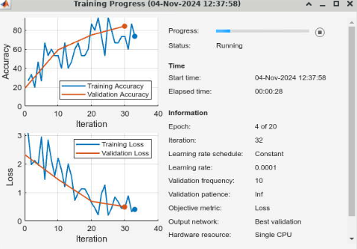
Training Progress
Include in your report.

Slide 21
Evaluate GoogLeNet Accuracy
Step 2.6
classNames = categories(imgsTrain.Labels);
scores = minibatchpredict(trainedGN,imgsValidation);
YPred = scores2label(scores,classNames);
accuracy = mean(YPred==imgsValidation.Labels);
disp("GoogLeNet Accuracy: "+num2str(100*accuracy)+"%")

Slide 22
Plot Confusion Matrix
% Convert categorical labels to use in the confusion matrix
trueLabels = imgsValidation.Labels;
predictedLabels = YPred;
% Plot confusion matrix
figure;
confusionchart(trueLabels, predictedLabels);
title("Confusion Matrix for Validation Set Predictions");

Slide 23
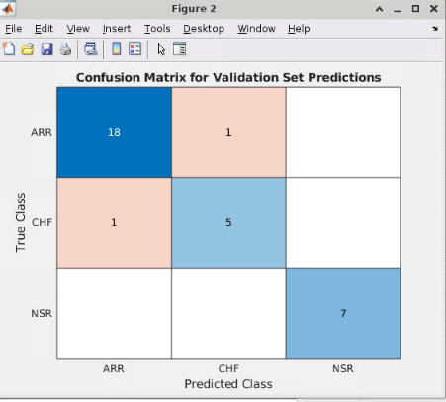
Confusion Matrix
Include in your report.

Slide 24
References
https://www.mathworks.com/help/wavelet/ug/classify-time-series-using-wavelet-analysis-and-deep-learning.html
https://viso.ai/deep-learning/googlenet-explained-the-inception-model-that-won-imagenet/
https://www.researchgate.net/figure/Simplified-illustration-of-the-GoogLeNet-architecture_fig5_364461190
https://data-science-blog.com/blog/2022/04/11/how-to-choose-the-best-pre-trained-model-for-your-convolutional-neural-network/

